Slide 1
Exploring the Plasma Focus-From Electrodynamics to Radiative Collapse
S Lee^{1.2.3} and S H Saw^{1,2}
¹Inti International University, Nilai Malaysia
²IPFS, Melbourne, KL, Singapore
³University of Malaya, KL, Malaysia

Slide 2
Computations suggest radiative collapse even in small PF devices, opening a new frontier in our multi-faceted numerical journey. This review starts from the basics, then touch on insights distilled by our efforts, and proceeds to the barely glimpsed world of radiatively-collapsed high energy density (HED) in the PF.
A schematic of the talk is summarised in the figure below.

Slide 3
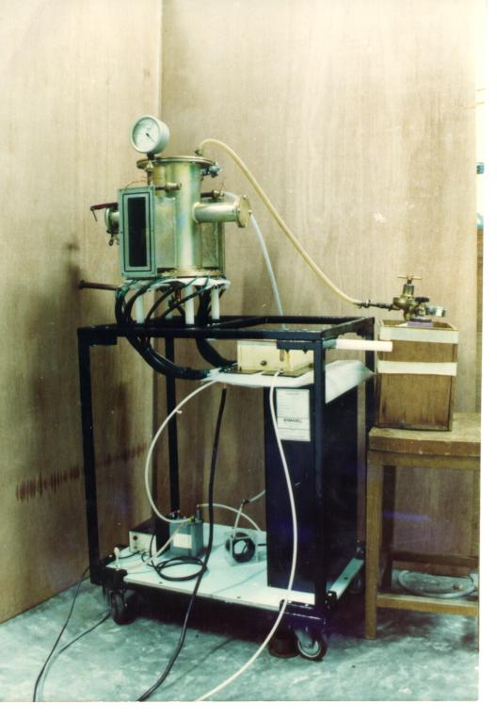
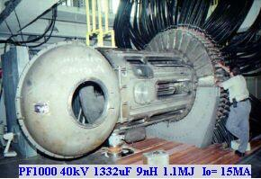
Range of Plasma Focus machines
3 kJ machine
1000 kJ machine

Slide 4
Plasma Dynamics in Plasma Focus
Radial Phase
Axial Accelaration Phase
Inverse Pinch Phase
HV
30 μF, 15 kV

Slide 6
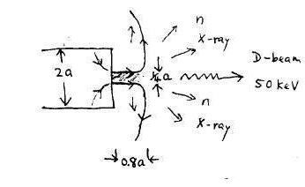
Emissions from the PF Pinch region
Mach500 Plasma stream
Mach20 anode material jet

Slide 7
Plasma Focus- Numerical Experiments
Parameters of experiments
Capacitor bank parameters
Tube parameters
Operational parameters
Model parameters

Slide 8
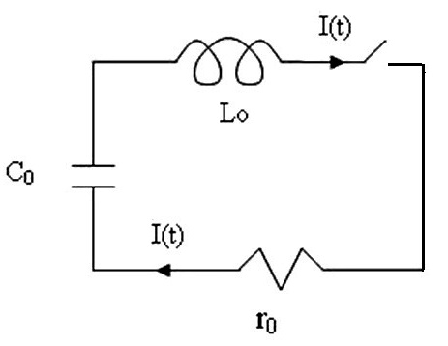
L₀-C₀-r₀ Discharge

Slide 9
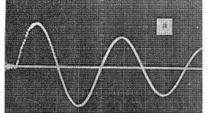
Capacitor bank discharged into short-circuit
Capacitor Discharge
Bank parameters: L₀, C₀, r₀ V₀
Discharge characteristics:
L₀-C₀-r₀ circuit, generates
Damped sinusoidal current
T=2π(L₀C₀)^{0.5}
I₀=V₀/(L₀/C₀)^{0.5}

Slide 10
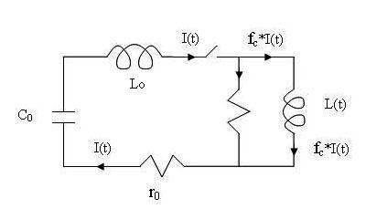
Plasma focus circuit

Slide 11
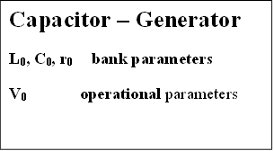
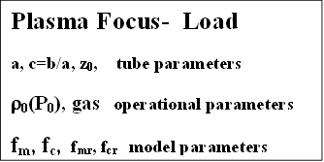
Capacitor bank discharged into PF tube

Slide 12
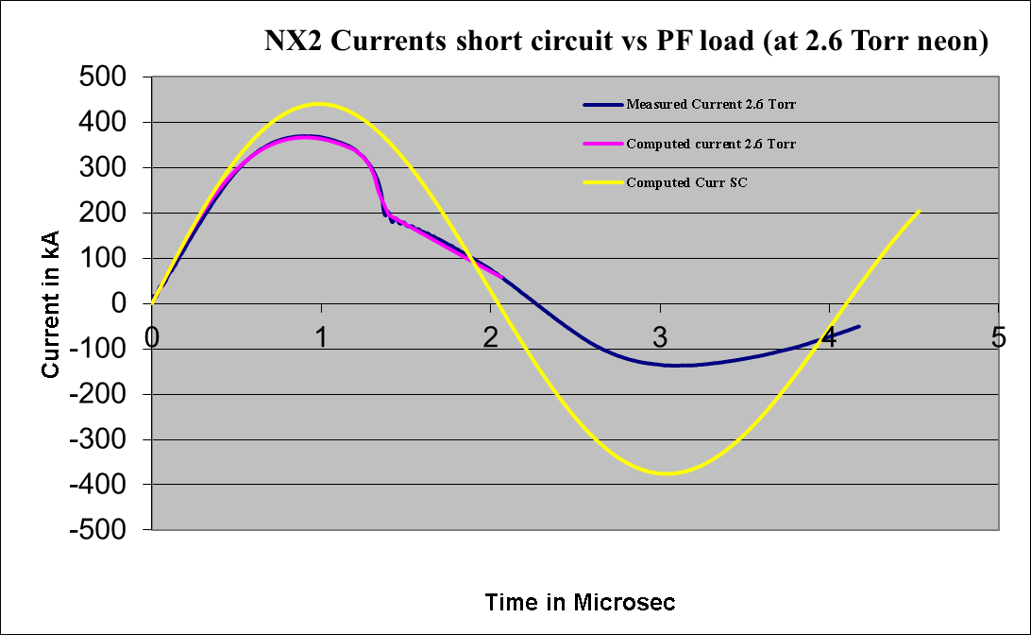
Capacitor bank- no load (SC) vs into PF tube

Slide 13
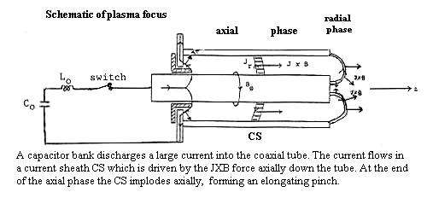
Diagnostics from modelling:
The Model Schematic

Slide 14
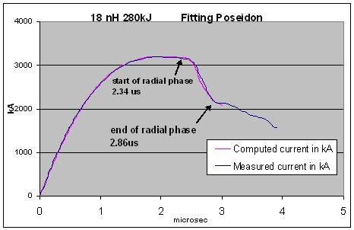
THE PLASMA FOCUS
The PF is divided into two sections.
Pre-pinch (axial) section: Delays the pinch until the capacitor discharge approaches maximum current.
The pinch starts & occurs at top of the current pulse.
Equivalent to driving the pinch with a super-fast rising current; without necessitating fast line technology.
The intensity which is achieved is superior to even the super fast pinch.

Slide 15
Two Main Phases of the Plasma Focus
Axial Phase
Radial Phase

Slide 16
Schematic of Code
Computes:
Axial phase-snowplow model: 2 coupled equations-1 motion, coupled with 1 circuit. Incorporates mass swept-up fraction f_{m}, and plasma current fraction f_{c}. These model parameters account for all axial effects not specifically modelled.
Radial inward shock phase-, Shock Front-Current Sheet slug with thermodynamics: 4 coupled equations, 3 motion, coupled with 1 circuit; radial mass swept-up factor f_{mr} and current factor f_{cr}. These two model parameters are applied for the radial phases
Reflected Shock RS Phase
Pinch radiative phase, including plasma self-absorption & possibility of radiative collapse
Post-compression large radius axial phase

Slide 17


Axial Phase (I) snow-plow model- 2 coupled equations for 2 variables z and I
Motion
Circuit

Slide 18
Additional Equations
Temperature and density in axial phase are calculated using shock-jump equations
Tube voltage is calculated

Slide 19
Analyse these 2 coupled Equations by dimensional analysis
Replace variables t, z, I by non-dimensionalised quantities as follows:
τ=t/t₀, ζ=z/z₀ and ι=I/I₀ where
t₀=(L₀/C₀)^{0.5} and I₀ = V₀/Z₀ where Z₀=(L₀/C₀)^{0.5} is the surge impedance.

Slide 20


2 Non-dimensionalised axial phase equations
Motion
Circuit

Slide 21
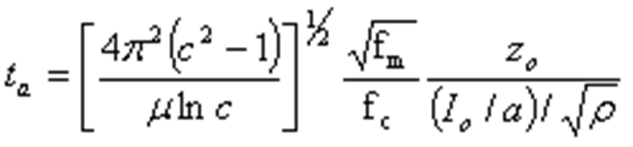
Axial Transit Time & 2 scaling parameters
This process identifies the axial transit time as:
And two scaling parameters: α = (t₀/t_{a}) and
β=L₀/L_{a}

Slide 22
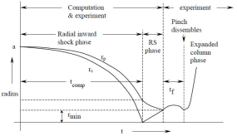
Radial Phase Slug Model

Slide 23


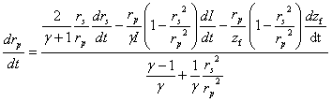
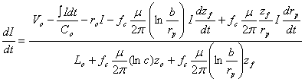
Radial phase (II) – 4 coupled equations
4 variables r_{s}, r_{p}, z_{f} and I
radial inward shock speed
Slug elongation speed
Radial Piston speed
Circuit

Slide 24
Additional Equations for Radial Phase
Temperature & density are calculated using Shock-jump equations. Tube voltage is calculated.
Thermodynamics properties:- charge number, specific heat ratio are calculated using Corona Model
Critical correction for finite communication speed (small disturbance speed) – an algorithm is applied to make this all-important correction
The above are also applied in the Reflected Shock Phase (III)

Slide 25
Normalisation of radial phase equations
τ = t/t_{o}, ι = I/I_{o} as in axial phase but with κ_{s} = r_{s}/a, κ_{p} = r_{p}/a, ζ_{f} = z_{f}/a ie. distances normalized to anode radius, instead of anode length.

Slide 26




Normalised radial equations- 4 coupled equations for 4 variables
Radial shock motion
Elongation of slug
Radial piston motion
Circuit

Slide 27

Characteristic radial transit time
Characteristic radial slug transit time revealed as:
2 scaling parameters
α=t_{a}/t_{r}

Slide 28

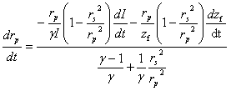

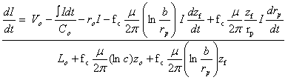
Reflected Shock (III) Phase, 4 coupled equations for 4 variables, r_{r}, r_{p}, z_{f} & I
Reflected shock speed
Piston Speed
Elongation Speed
Circuit

Slide 29
Additional Equations for RS Phase
Same as for Radial Shock Phase

Slide 30

Pinch Phase (IV) - 4 coupled equations with 4 variables - r_{p}, z_{f} , I & Q
Radiation-coupled Piston Speed
Pinch elongation- similar to earlier equation
Circuit – similar to earlier equation
Energy gain/loss Q coupled into dynamics

Slide 31
Additional Equations-Pinch Phase
Density- use mass conservation
Temperature- use Bennett balance
Plasma Resistance- use Spitzer equation

Slide 32
Additional Equations – Pinch Phase
Q has following components:
Joule heat- Use Ohm equation
Bremsstrahlung, recombination and line radiation- use respective radiation power equations; sum for total radiation power
Plasma self-absorption- computed using a schematic developed jointly with N A D Khattak

Slide 33
Additional Equations- Pinch Phase
Characteristic radiation of a gas- Line radiation is integrated within a temperature window based on ionization levels; e.g. Ne SXR yield
Neutron yield- calculated using thermonuclear model + beam-gas target model (calibrated to globally measured yield curve)
Beam ions fluence, flux etc properties,
Fast Plasma Stream- computed from plasma inductive energy conversion.

Slide 34
Post-Pinch axial phase (V)- 2 coupled equations with 2 variables
Similar to Axial Phase (I) with objective to complete the computed current waveform

Slide 35
Integration of equations- scheme
t=0, set initial values for d²z/dt, dI/dt
Increment t, integrate for z and I, calculate new values for d²z/dt, dI/dt etc
Point-by-point sequentially, each phase below:
Axial phase
Radial inward phase
RS phase
Pinch phase
Post pinch large column axial phase

Slide 36
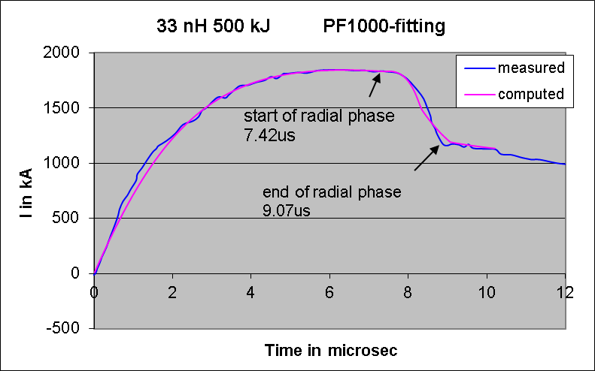
Connecting code and reality- fitting the computed current waveform to the measured waveform
Fitting parameters:
axial phase: f_{m} and f_{c}
Radial phases: f_{mr} and f_{cr}

Slide 37
Significance of I_{total} current fitting
f_{m}: mass swept up factor, axial phase
accounts for all effects affecting mass swept up (structure inclination, porosity, boundary layer etc)
f_{c}: plasma current factor, axial phase
accounts for all effects affecting current flowing in the plasma (current leakage to backwall, shunting and fragmenting, CS inclination etc), defines the fraction of I_{total} effectively driving the magnetic piston
f_{mr}: mass swept up factor, radial phase
accounts for all effects affecting mass swept up (structure inclination, porosity, axial mass streaming etc)
f_{cr}: plasma current factor, radial phase
accounts for all effects affecting current flowing in the plasma (current leakage to backwall, CS bifurcation, current constriction/disruption etc) defines the fraction of I_{total} effectively driving the magnetic piston
We fit the computed I_{total} waveform to the measured because the I_{total} waveform is the one usually measured. Once the I_{total} waveform is fitted by adjusting the 4 model parameters, the I_{plasma} waveform is also implicitly fitted.

Slide 38
Fitting Procedure- the 5-point fit
The 5-Point Fit:
First, the axial model factors f_{m}, f_{c} are adjusted (fitted) until
  (1) computed rising slope of the I_{total} trace and
  (2) the rounding off of the peak current as well as
  (3) the peak current itself
  are in reasonable (typically very good) fit with the measured I_{total} trace.
Next, adjust (fit) the radial phase model factors f_{mr} and f_{cr} until
- (4) the computed slope and
- (5) the depth of the dip
agree with the measured I_{total} waveform.

Slide 39
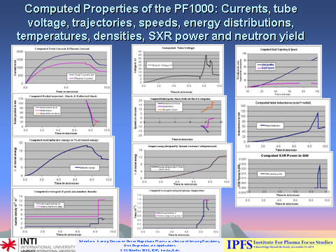
Once fitted, the code outputs the properties of the PF

Slide 40
Recent results from our numerical experiments suggest the possibility of radiative collapse (limited by plasma self-absorption) occurring in even small plasma focus devices. Hence a timely review of our numerical exploration of the multi-faceted world of the plasma focus is presented. This is meant to be a comprehensive wide-ranging survey of our numerical journey- starting from the basics, touching on insights distilled by our efforts, to the barely glimpsed world of radiatively-collapsed high energy density (HED) which our code is helping to reveal. A schematic of the talk is summarised in the figure below.

Slide 41
Applications of the Code
Reference for diagnostics: dynamics, pinch size and lifetimes, SXR yields, neutron yields, ion beams and FPS; anomalous resistance, amplitudes and time scales-applied to many PF’s, including tapered PF, curved anodes and hemispherical anode
Design & optimization: UNU/ICTP PFF (network) , NX2, NX3, FMPF (Singapore), FNII (Mexico), UBA (Argentina), KSU (USA), FOFU (USA), other machines Chile, Iran, Syria etc, DuPF
Special designs: current-stepped PF, multi-MJ PF
ML: modification of code schematic to Filippov machines

Slide 42
Insights from code
Current and neutron limitations as inductance is reduced towards small values e.g. 10 nH
Scaling properties of PF: speed, T, density
Scaling properties for SXR , neutron, beam ions & FPS
Scaling laws of SXR , neutron, beam ions (FIB) & Fast Plasma Streams (FPS)
Deterioration of neutron and radiation yield scaling
SFM- advantageous for materials deposition
Radiative cooling and collapse for HED

Slide 43
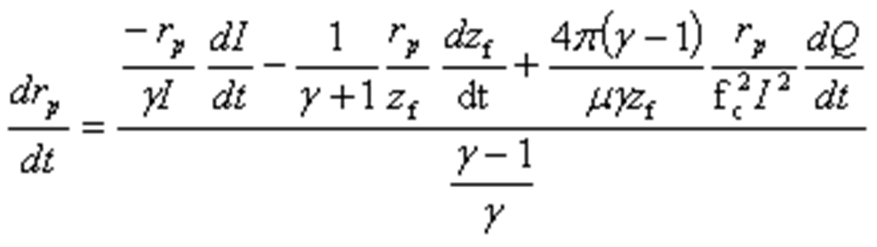
Radiative Cooling and Collapse
Pease-Braginskii proposed the mechanism of radiative collapse for a Z-pinch in hydrogen - PS current is 1.4 MA
Our Radiation-coupled dynamic equation:
If we put the term dQ/dt=0, and consider the radiation part of Q to consist only of bremsstrahlung, then we have the P-B limit.

Slide 44
Reduced P-B limit for high Z gases
For higher Z gases such as neon, line radiation predominates and since line radiation is many times more in power than bremstrahlung at PF conditions, the P-B limit current is reduced to less than 100 kA in the case of argon, Kr and Xe.
The code demonstrates radiative collapse in small devices, including the INTI PF.

Slide 45
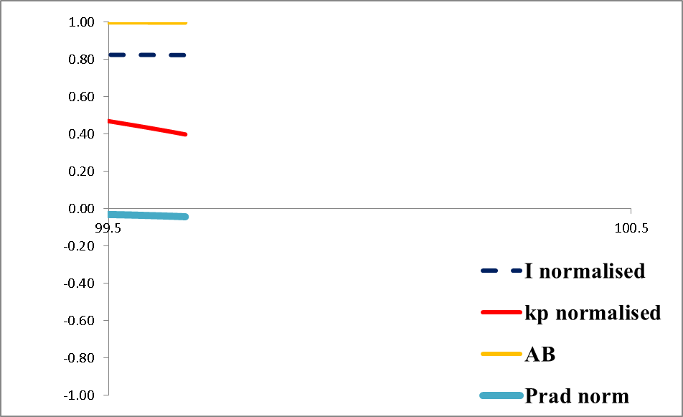
Bennett Pinch-Plasma Pressure balances Magnetic Field

Slide 46
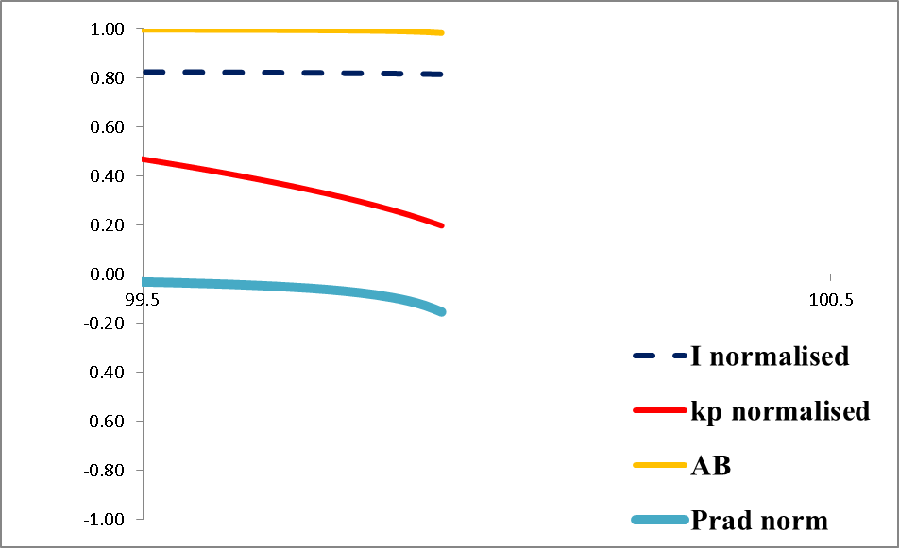
Radiative collapse starts- intense radiation cools plasma, leading to lower plasma pressure, dQ/dt term dominated by radiation

Slide 47
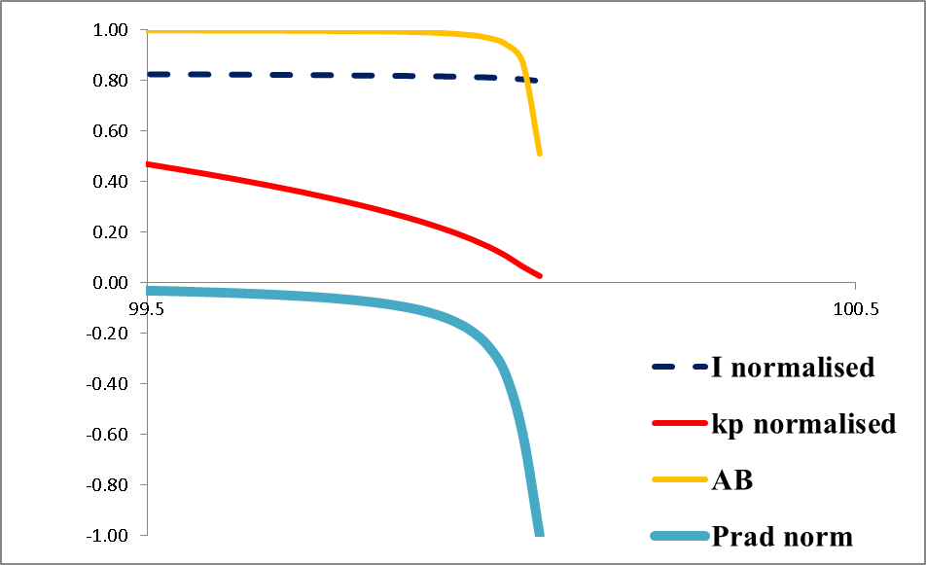
Radiative collapse continues- plasma density increases, plasma begins to absorb its own radiation- becoming partially opaque to its own radiation

Slide 48

Radiative collapse stops- plasma density is so high that plasma absorbs sufficient radiation from its volume to stop the radiative collapse

Slide 49
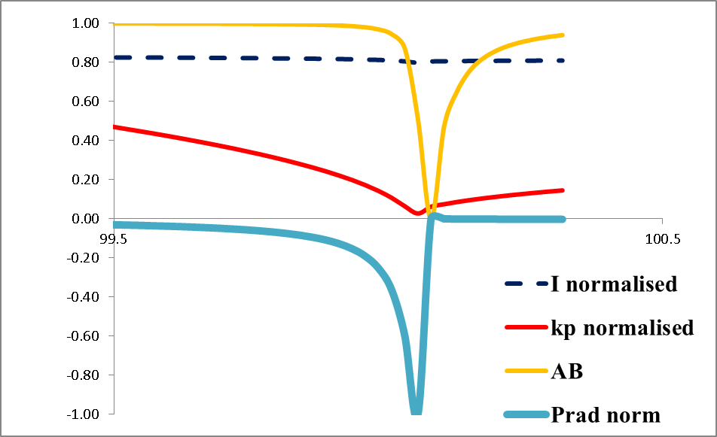
Pinch expands- radiation becomes insignificant; Joule heating now dominates dQ/dt term

Slide 50
Observation of radiative collapse in INTI PFCurrent fitting for 0.5 Torr Kr
Fig 1. Fitting the computed current trace to the measured current trace of INTI PF at 12 kV 0.5 Torr Kr (shot 631).

Slide 51
Computed Radial Trajectory showing Radiative Collapse
Fig 2 shows the radial trajectory corresponding to the fitting of the current waveform of Fig 1 for INTI PF 12 kV, 0.5 Torr Kr.

Slide 52
Correlating Radiative Collapse with Line Radiation Power
Normalisation: I: 145 kA, kp: 0.0014, Pline: 3.7 TW

Slide 53
Correlating RC Trajectory with P_{line}
The pinch compresses to a radius of 0.0013 cm; kp = 0.0014.
The radiative collapse is ended when plasma self-absorption attenuates the intense line radiation.
The rebound of the pinch radius is also evident.
This intense compression, reaches 3.7 × 10²⁶ ions m⁻³, which is 15 times atmospheric density (starting from less than 1/1000 of an atmospheric pressure).
Energy pumped into the pinch is 250 J whilst 41 J are radiated away in several ns,
Most of the radiation occurs in a tremendous burst of 50 ps
Peak radiation power:- almost 4 × 10¹² W.
The energy density at peak compression is 4 × 10¹³ J m⁻³ or 40 kJ mm⁻³.
Thus even in this small plasma focus intense HED is achieved with immense radiation power.

Slide 54
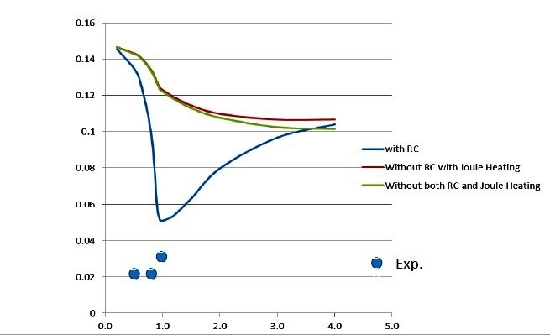
PF1000- 23 kV 1.1 MA pinch current: Pinch radius ratio versus pressure: Comparison of code with time-resolved imaging-
* from Experiments and Simulations on the Possibility of Radiative Collapse in the Plasma Focus PF-1000- M. Akel, J. Cikhardt, P. Kubes, H.-J. Kunze, S. Lee, M. Paduch, and S. H. Saw- PLASMA 2015, Warsaw, September 7-11, 2015

Slide 55
Conclusion
Model:- phases, equations
Applications:- dynamics and properties, reference for diagnostics, design & optimisation,
Insights:- scaling properties & scaling laws for SXR, neutrons, FIB & FPS,
-deterioration of yield scaling
- Slow Focus Modes with advantages for materials deposition
-Radiative cooling and collapse for HED

